Slide 1




DIGITAL LITERACY
SKILLS

Slide 2

Module 1
Foundation digital skills

Slide 3

1
Unit 1: Basics of a computer

Slide 4

Starting up a computer safely
To start up a computer
Find the power button.
On-buttons can be in different places.
To start up the computer, press the power button and wait for it to start up.

Slide 5
Shutting down a computer safely
To shut down a computer safely
First close any open programs and save any open documents.
Then navigate to the power settings of the computer.
Select the option that says Power off or Shut down.

Slide 6

Components and accessories
Hardware and software
Hardware: The physical parts of the computer that run when they receive instructions from the software.
Software: The sets of instructions that can be stored on the computer and that hardware uses to run.

Slide 7
A computer uses the components for input, processing, output, and storage
STORAGE COMPONENTS
INPUT COMPONENTS
OUTPUT COMPONENTS
PROCESSING COMPONENTS

Slide 8

Operating systems
Keep it simple: A simple search term is better for getting specific results. For example: beans recipe.
Consider suggestions: As you type, the search engine may give you suggestions. These can be useful and improve the quality of your results.
Use natural language: You can type questions directly into a search engine, for example: “What do cats eat” or “Directions from X to X”

Slide 9
Skills to practise
Make two lists with these headings:
Components of a computer
Accessories of a computer
Put each of these tools under the right heading.
SD card | printer | CD | hard drive | joystick | microphone
keyboard | monitor | touch screen | virtual keyboard | CPU | USB drive
speaker | remote | webcam | headphones | scanner | external hard drive
Continue >

Slide 10
Skills to practise
Add to the lists if there are any other components or devices you can think of.
Next to each component or accessory, write these letters:
i – input
o – output
p – processing
s – storage

Slide 11
Word processing software
1
2
3
Create a document:
blank
template
Save a document
Edit a document

Slide 12
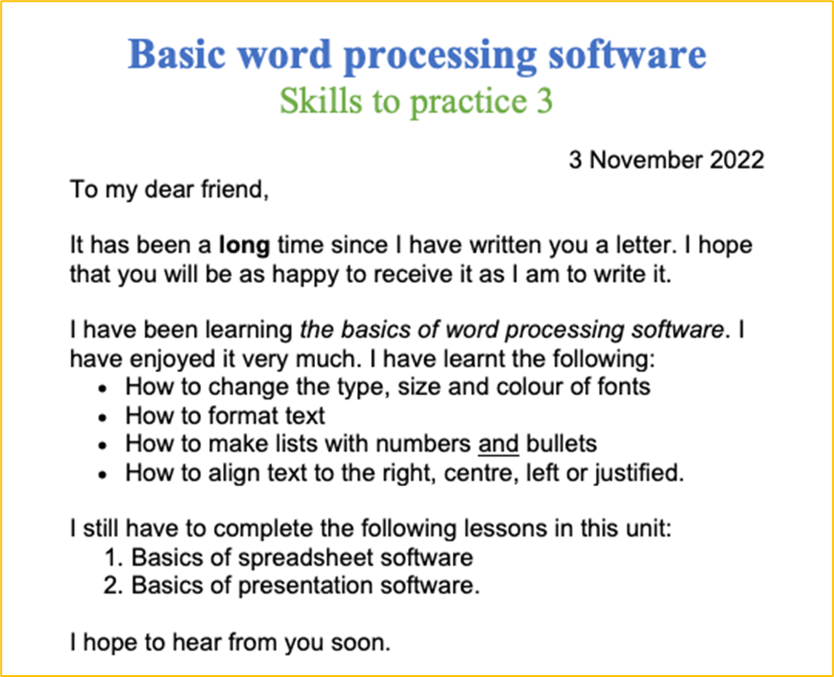
Skills to practise
Create a blank document.
Save your document with an appropriate name. Remember the rules for naming files correctly.
Edit your document to look like this example. Follow these guidelines:
Use any fonts of your choice, but you must use two, as per the example.
The blue heading must be 28 pt.
The green heading must be 24 pt.
The formatting, alignment and lists must be the same as in the example.
Continue >

Slide 13
Skills to practise
Carefully go over your document one last time to make sure you have copied this example correctly.
If you are done with your document, remember to save again.
Carefully go over your document one last time to make sure you have copied this example correctly.
If you are done with your document, remember to save again.

Slide 14
Spreadsheet software
1
2
3
Create a blank spreadsheet
Save a spreadsheet
Edit a spreadsheet

Slide 15
Skills to practise
Create a blank spreadsheet.
Save your spreadsheet with an appropriate name. Remember the rules for naming files correctly.
Edit your spreadsheet according to these guidelines:
Merge row 1 and 4 from column A to column F.
Column F must have its width increased by another row’s width.
Add the heading Skills to practise 4 in the top merged row that is:
in a font of the learner’s choice
22 pt size
in any shade of blue
Continue >

Slide 16
Skills to practise
formatted in bold
left-aligned (horizontally)
top-aligned (vertically)
Add all borders to the cells from A1 across to F1 and down to row 10.
Row 10 must be filled in any shade of grey.
Cells B5 to B9 and D5 to D9 must be filled in green.
Row 5 to 10 must be centre-aligned.
Row 5 to 10 must use the currency number format for United States Dollars with two decimal places.
Continue >

Slide 17
Skills to practise
Type the following data into the spreadsheet into the specified cells. Currency symbol and decimals will be added automatically.
Cell reference | Value |  | Cell reference | Value |  | Cell reference | Value
A5 | 100 |  | C5 | 10 |  | E5 | 999
A6 | 200 |  | C6 | AAA |  | E6 | 111
A7 | 300 |  | C7 | 20 |  | E7 | 777
A8 | 400 |  | C8 | BBB |  | E8 | 333
A9 | 500 |  | C9 | 30 |  | E9 | 555
Continue >

Slide 18
Skills to practise
Do the following calculations on the spreadsheet in the specified cells.
Cell reference | Calculation | Suggested formula | Correct answer
A10 | Add A2 to A9 | =SUM(A5:A9) | $1500,00
C10 | Count the numbers in the cells | =COUNT(C5:C9) | 3
E10 | Highest value from E5 to E9 | =MAX(E5:E9) | $999,00
F5 | Average number from A5 to A9 | =AVERAGE(A5:A9) | $300,00
F6 | Lowest value in all cells | =MIN(A5:E9) | $10,00
Continue >

Slide 19
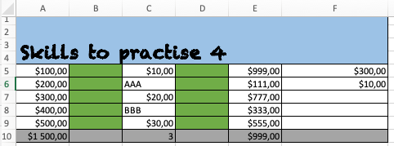
Skills to practise
Carefully go over your spreadsheet one last time to make sure you have followed all the steps correctly.
If you are done with your spreadsheet, remember to save it again.

Slide 20
Presentation software
1
2
3
Create presentation
blank slides
template slides
Save a presentation slide deck
Edit a presentation slide deck

Slide 21
Skills to practise
Create a blank presentation.
Save your presentation with an appropriate name. Remember the rules for naming files correctly.
Use all the skills you have learnt about in this unit to create a presentation
Your presentation must have six slides.
Each slide must have a heading.
The content on each slide must explain what you have learnt in that lesson.
Continue >

Slide 22
Skills to practise
SLIDE NUMBER | TITLE | CONTENT
1 | Introduction to computers | Computers Starting up a computer safely Shutting down a computer safely
2 | Hardware | Hardware Components of a computer Accessories of a computer
3 | Operating system software of a computer | Software Operating system software of a computer
4 | Word processing software | Creating a document Editing a document
5 | Spreadsheet software | Creating a spreadsheet Editing spreadsheets
6 | Presentation software | Creating a presentation Editing a spreadsheet
Continue >

Slide 23
Skills to practise
The following must be in your presentation:
Fonts (types, sizes, colour)
Formatting (bold, italics, underlining)
Alignment (top, middle, bottom and left, right, centre, justified)
Lists (bulleted and numbered)
Animations
Transitions
Pictures / Audio / Video
If you are done with your presentation, remember to save it again.
Continue >

Slide 24
All back covers should include
contact information of the section
producing the work.
© United Nations Children’s Fund (UNICEF) [month and year of publication]

